Slide 1


Arduino - Spotify
Controller
A Project By:
Daniel Aviv and Ayal Moran

Slide 2
Introduction
Overview
The purpose of this project is to create a more interactive and accessible user experience for Spotify, allowing users to control their music playback through simple hand movements.
The system utilizes:
an Arduino UNO R3 microcontroller.
Four Ultrasonic sensors (PING))) are used for gesture interpretation.
Hardware components are simulated on TinkerCAD.
Python is used to scrape data from the TinkerCAD serial monitor.

Slide 3


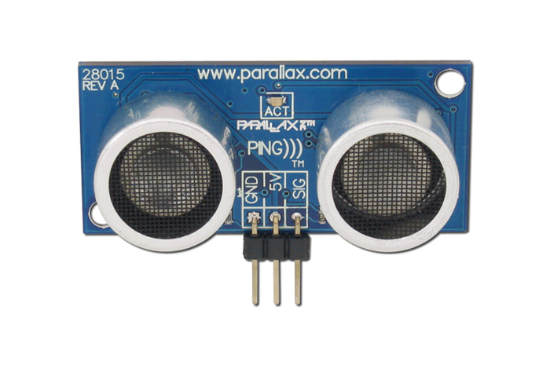
System Design
The system design of our project can be divided into three components:
Hardware design
Software implementation
The interface between hardware and software.
Hardware Design
Software Implementation
Hardware-Software Interface
Core component: Arduino UNO R3 microcontroller.
Input: Four Ultrasonic Sensors (PING))) for detecting hand distance.
Simulation: Hardware setup simulated on TinkerCAD for easy modifications and troubleshooting.
Developed in C/C++, designed to run on Arduino UNO R3.
Continuously monitors ultrasonic sensors for gesture detection.
Interprets sensor data to determine gestures.
Performs corresponding actions: play, pause, next track, previous track, volume up, and volume down.
Interface between Arduino and Spotify API through Python script.
Python script scrapes serial monitor of TinkerCAD for commands sent by Arduino.
Script sends corresponding request to Spotify API, controlling Spotify playback.

Slide 4
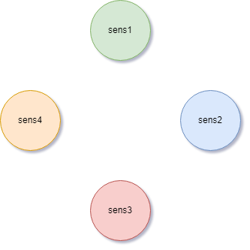

Gestures

Slide 5
Gestures
PLAY
STOP
NEXT
PREVIOUS
VOLUME UP
VOLUME DOWN

Slide 6
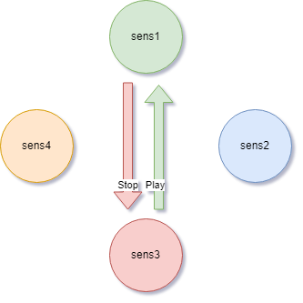
Gestures
Play\Stop
Play - [3 , 1]
Stop - [1 , 3]

Slide 7
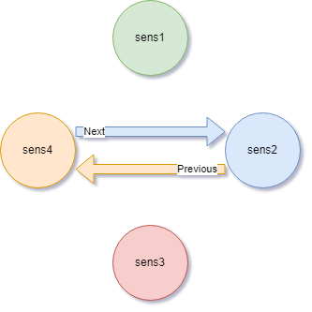
Gestures
Next\Previous
Next- [4 , 2]
Previous - [2 , 4]

Slide 8
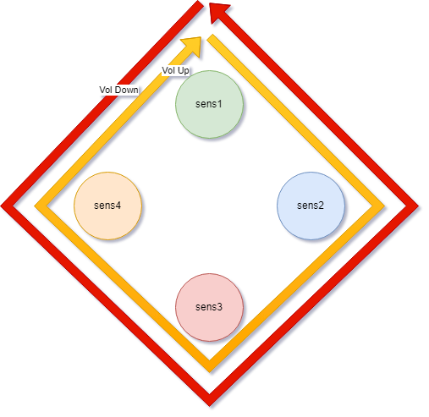
Gestures
Vol Up\Vol Down
Vol Up- [1 , 2 , 3 , 4]
Vol Down - [1 , 4 , 3 , 2]

Slide 9
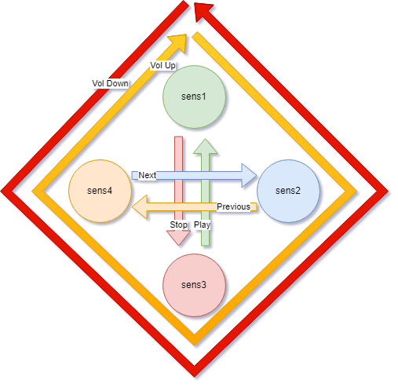
Gestures
The gestures used to control Spotify:
Play\Stop
Next\Previous
Volume Up\Volume Down

Slide 10
Gestures
The gestures used to control Spotify:
Play\Stop
Next\Previous
Volume Up\Volume Down

Slide 11
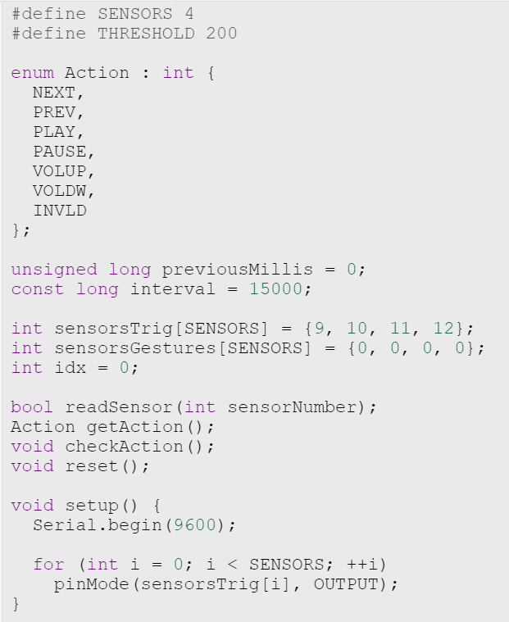
Implementation
Setup

Slide 12
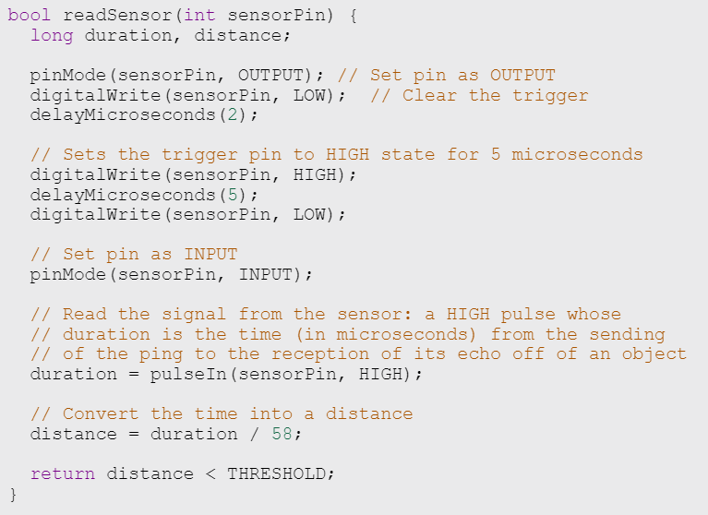
Implementation
Setup
Helper Functions:
readSensor()

Slide 13
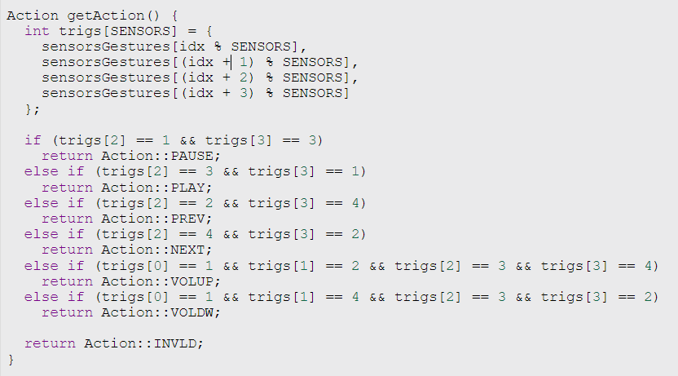
Implementation
Setup
Helper Functions:
readSensor()
getAction()
Notes:
להוריד את הדיבוג בהדפסות

Slide 14
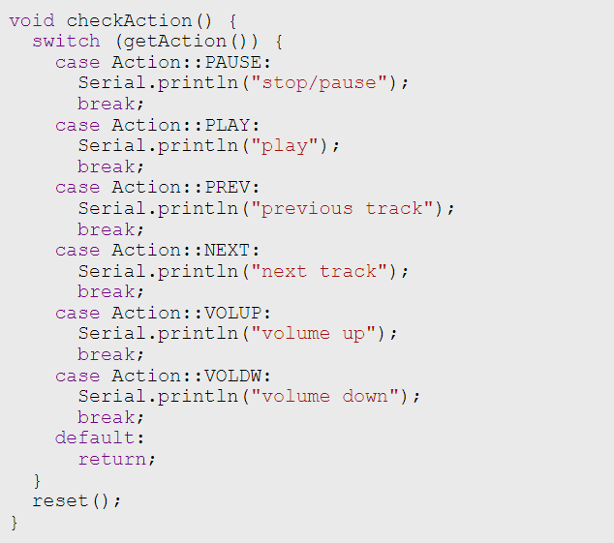
Implementation
Setup
Helper Functions:
readSensor()
getAction()
CheckAction()

Slide 15
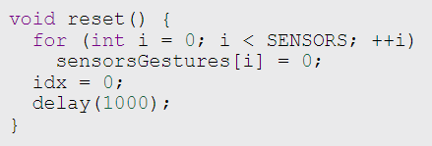
Implementation
Setup
Helper Functions:
readSensor()
getAction()
CheckAction()
reset()

Slide 16
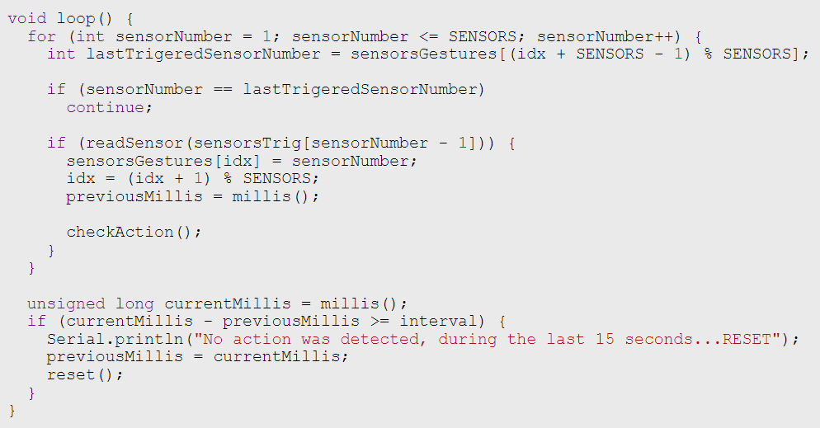
Implementation
Setup
Helper Functions:
readSensor()
getAction()
CheckAction()
reset()
Main Loop

Slide 17



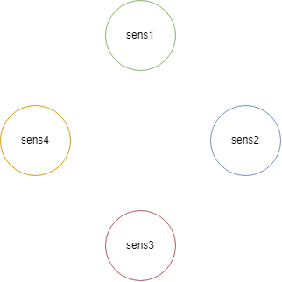
0
0
0
0
idx = 0;
idx % 4 = 0;
[0]
[1]
[2]
[3]
SensorsGestures[]
Last Sensor Trigger

Slide 18
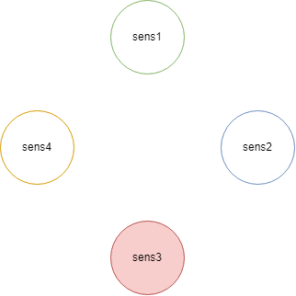
3
0
0
0
idx = 1;
idx % 4 = 1;
[0]
[1]
[2]
[3]
SensorsGestures[]
Last Sensor Trigger

Slide 19

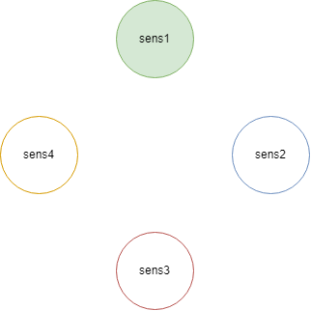
3
1
0
0
idx = 2;
idx % 4 = 2;
[0]
[1]
[2]
[3]
SensorsGestures[]
Last Sensor Trigger
getAction() returns: -> 'PLAY'; [3,1]
checkAction() sends 'PLAY' to Serial Monitor and reset();

Slide 20
0
0
0
0
idx = 0;
idx % 4 = 0;
[0]
[1]
[2]
[3]
SensorsGestures[]
Last Sensor Trigger

Slide 21
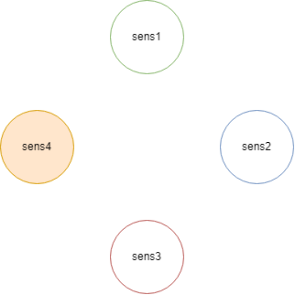
4
0
0
0
idx = 1;
idx % 4 = 1;
[0]
[1]
[2]
[3]
SensorsGestures[]
Last Sensor Trigger

Slide 22
4
3
0
0
idx = 2;
idx % 4 = 2;
[0]
[1]
[2]
[3]
SensorsGestures[]
Last Sensor Trigger

Slide 23
4
3
4
0
idx = 3;
idx % 4 = 3;
[0]
[1]
[2]
[3]
SensorsGestures[]
Last Sensor Trigger

Slide 24
4
3
4
1
idx = 4;
idx % 4 = 0;
[0]
[1]
[2]
[3]
SensorsGestures[]
Last Sensor Trigger

Slide 25
3
3
4
1
idx = 5;
idx % 4 = 1;
[0]
[1]
[2]
[3]
SensorsGestures[]
Last Sensor Trigger
getAction() returns: -> 'STOP'; [1,3]
checkAction() sends 'STOP' to Serial Monitor and reset();

Slide 26
0
0
0
0
idx = 0;
idx % 4 = 0;
[0]
[1]
[2]
[3]
SensorsGestures[]
Last Sensor Trigger

Slide 27
DEMO

Slide 28
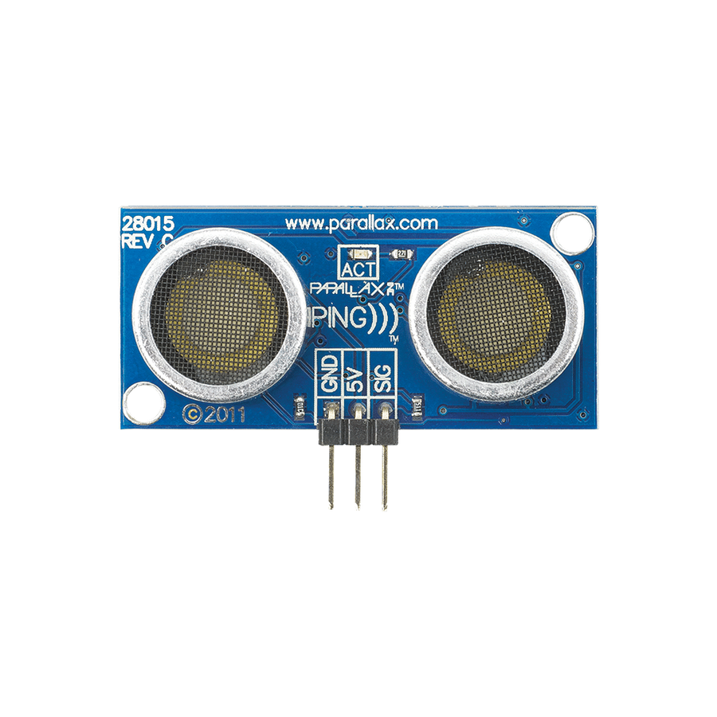
Conclusion
To sum up, this project shows how we can use hand gestures to interact with apps like Spotify. We've created a simple and fun system that lets you control Spotify with your hand movements. This project is a great example of how combining technology and design can lead to really cool results.

Slide 29
Thank You!
Special thanks to:
Vladi Budnitski
Dr. Yakov Damatov
Creators
Ayal Moran - moranayal@gmail.com
Daniel Aviv - dani6laviv@gmail.com

